Slide 1
Translating Bolts: LTL_{f} and STRIPS Based Restraining Bolts on the Taxi-v3 Environment
Claudia Melis Tonti: 1888489
Lorenzo Papa: 1699806
Nicolas Zaccaria: 1904366
Roberto Gallotta: 1890251

Slide 2
Temporal Logic & Deterministic Finite Automaton
I

Slide 3



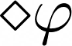
Temporal Logic (TL)
Logic language that offers some time-related rules and operators
to deal with propositions in which truth varies with time
Semantic
Syntax
Graph representation: Kripke Model
Facts can be true or false in more situations called possible worlds
The set of possible worlds lies on a timeline
Not, And, Or connectives
Necessarily operator states that
is true in all the possible worlds
Possibly operator states that
is true or will be true in all the possible worlds

Slide 4
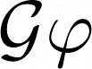
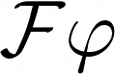
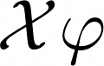
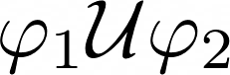
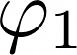
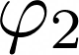
Linear Temporal Logic (LTL)
An extension of TL with:
Semantic
Syntax
Describes the evolution over time as
a sequence of time-points: trace
Formulas are evaluated over a trace
As standard, LTL traces are infinite
LTL can be also used over finite traces
(LTL_{f} ) with a lower expressive power
Globally : states that is true
now and in all the future time points
Finally : states that is true now
or it will at some time point in the future
Next : states that will be
true in the next time point
Until : states that is true
until is true

Slide 5
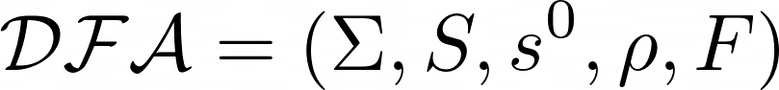


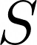
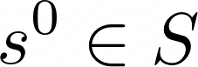
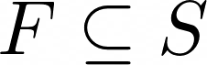
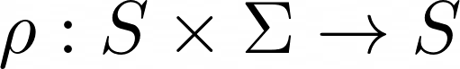
Deterministic Finite Automaton (DFA)
Finite state machine that takes a string of symbols as input and,
running through a sequence of states, may accept or reject it.
May be represented as a graph:
with:
a finite and non-empty alphabet, where a word is an element of
a finite and non-empty set of states
the initial state
the set of accepting states
a transition function

Slide 6
Reinforcement Learning
II

Slide 7
Reinforcement Learning
improve the ability of performing some task with experience: learning
Given a set of States, Actions and Rewards:
Learn an optimal behavior function:

Slide 8
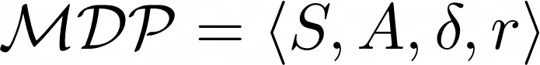

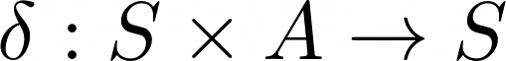
Reinforcement Learning
modeled as a time-discrete system: Markov Decision Process
with:
a finite set of states
a finite set of actions
a transition function
a reward function

Slide 9
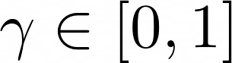
Reinforcement Learning
Aims to maximize the expected cumulative discounted reward:
where
is the discount factor
To obtain the optimal policy:

Slide 10
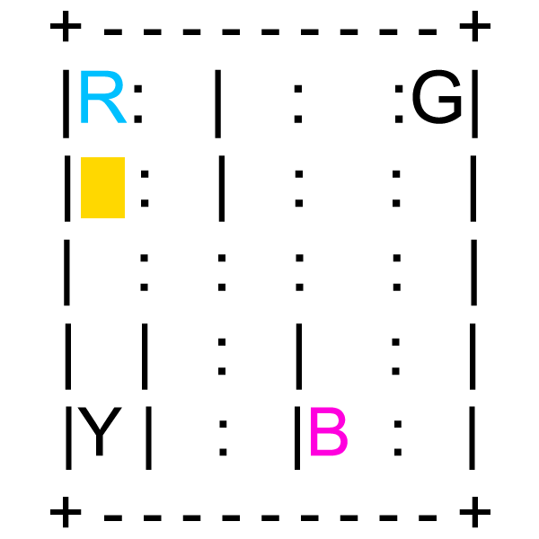
Taxi-v3
Goal: pick up the passenger and drop him off at the destination
Actions:
Move North
Move South
Pick up
Move West
Move East
Drop off
Rewards:
Default per-step -1
Illegal Pick up and Drop off -10
Successful Drop off +20

Slide 11
Restraining Bolts &
Automata as Reward Shaping
III

Slide 12
Temporal Goals
IDEA:
Make the agent learn to reach a set of temporal goals until it reaches the final goal.
THE PROBLEM IT FIXES:
The RL algorithm behavior may degenerate into a random walk

Slide 13
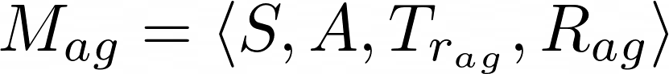
Restraining Bolts
WHAT IS IT:
A restraining bolt restricts the agent’s actions limiting them to a set of wanted behaviors.
Agent’s world representation
Restraining Bolt’s world representation
Reinforcement Learning

Slide 14
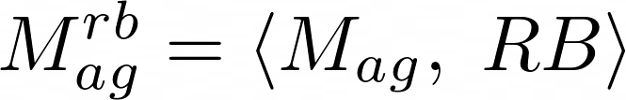
Restraining Bolts
THE RL PROBLEM:
THE SOLUTION:
For each Φi compute the DFA AΦi
Do RL on

Slide 15
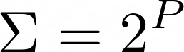
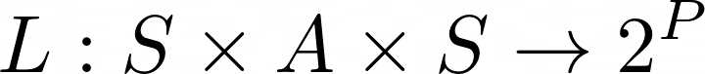
Automata as Reward Shaping
Reward Machine <S,A,P,L> = Mealy Machine <Q, q0, Σ, R, δ, ρ> where:
The idea is to approximate the cumulative discounted reward in any RM state by using the RM itself as a MDP.
The resulting reward shaping is:

Slide 16
Reward Shaping
& STRIPS
IV

Slide 17

Reward Shaping
In Reinforcement Learning: Consisting of supplying additional rewards to a learning agent
Pros:
Helps the agent in achieving the optimal policy faster
Guide the learning process more efficiently
Final Reward = MDP Reward + Reward Shaping

Slide 18
Reward Shaping
IDEA:
Engineering a Reward Function to provide more frequent feedback on appropriate behaviours
RELATED WORKS:
Policy invariance under reward transformations: Theory and application to reward shaping [1]
Potential-Based Reward Shaping
(PBRS)
[1] Andrew Y Ng, D.H., Russell, S.: Policy invariance under reward transformations:Theory and application to reward shaping (1999)

Slide 19

Reward Shaping
Markov Decision Process: M = (S, A, δ, R)
Reward Shaping function: F(s, a, s’)
R = R(s, a, s’)
R’(s, a, s’) = R(s, a, s’) + F(s, a, s’)
[1] Andrew Y Ng, D.H., Russell, S.: Policy invariance under reward transformations:Theory and application to reward shaping (1999)

Slide 20
STRIPS
STanford Research Institute Problem Solver:
A problem solver that aims to find the optimal sequence of operators
Initial State
Final State (goal)
Problem Space:
𝚷 =〈P, O, I, G〉
cost(𝛑_{opt}) < cost(𝛑’)

Slide 21
STRIPS to LTLf
Translate from STRIPS formalism to an equivalent LTLf formula:
Define the domain with a set of fluents
From STRIPS to LTLf [2]
Define each action with a precondition
Encode the Initial set of fluents, as TRUE states
Encode the Final set of fluents that eventually hold
STRIPS
LTLf
DFA
Automata
[2] De Giacomo, G., Vardi, M.Y.: Linear temporal logic and linear dynamic logic on finite traces. In: Proceedings of the Twenty-Third International Joint Conference on Artificial Intelligence. IJCAI ’13, AAAI Press (2013) 854–860

Slide 22
Our experiments
V
Overview of experiments and discussion of results

Slide 23
LTL_{f} Temporal Goals
Increasingly complex temporal goals described by LTL_{f} formulas:
Base environment goal: a U (b U c)
Pass through center: a U (b U (c U d))
Pass through 1 corner: a U (b U (c U d))
Pass through 2 corners: a U (b U (c U (d U e)))
Pass through 3 corners: a U (b U (c U (d U (e U f))))
Generate DFA from LTL_{f} formulas to track Temporal Goal.
Meaning of fluents changes according to specific environment initialization.
We test both with and without Reward Shaping

Slide 24
STRIPS Temporal Goals
Define the base environment goal as STRIPS problem.
Convert STRIPS to LTL_{f} and then to DFA.
Ensure no don’t care and terminal state in formula.
Introduction of Step Controller in the training and testing loop to compensate loopless DFA states.

Slide 25
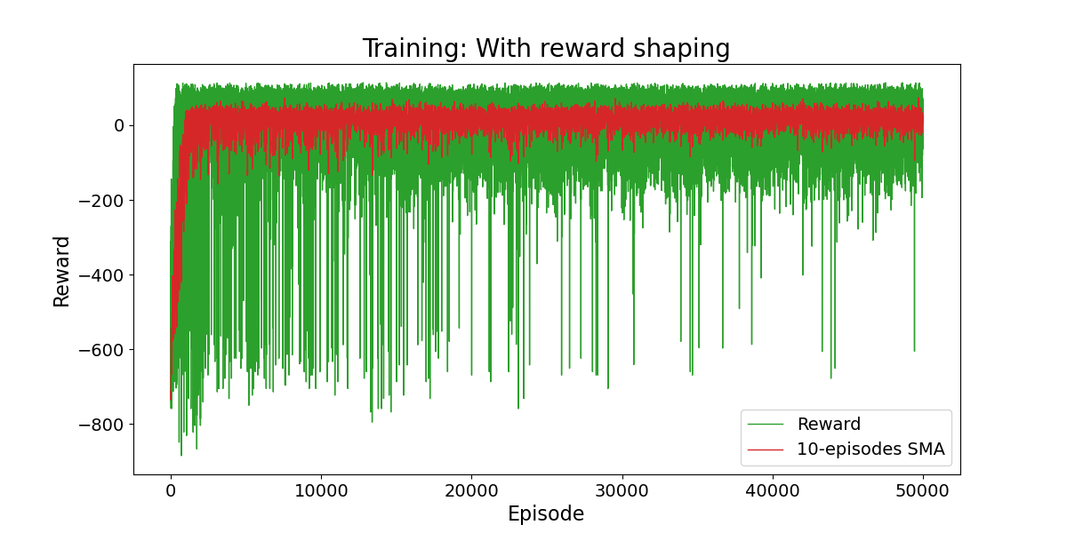
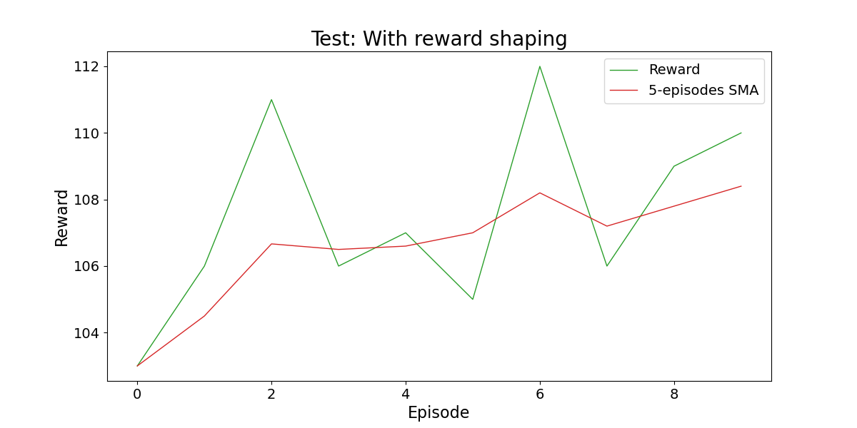
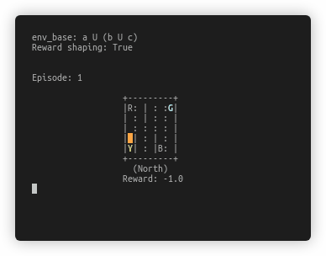
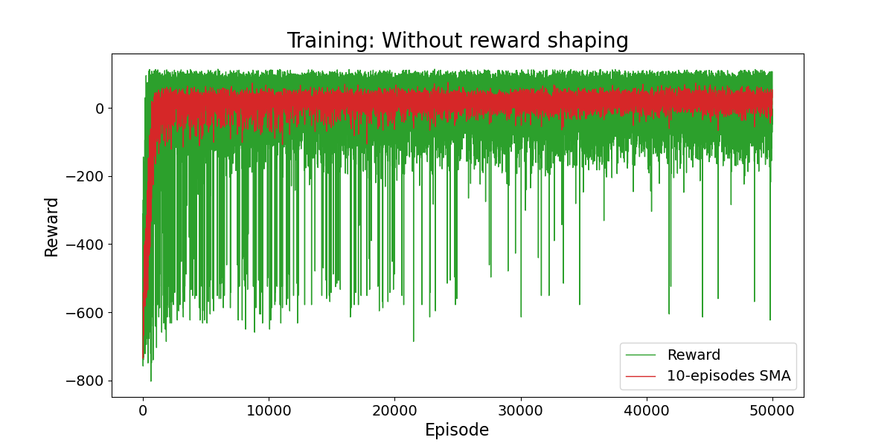
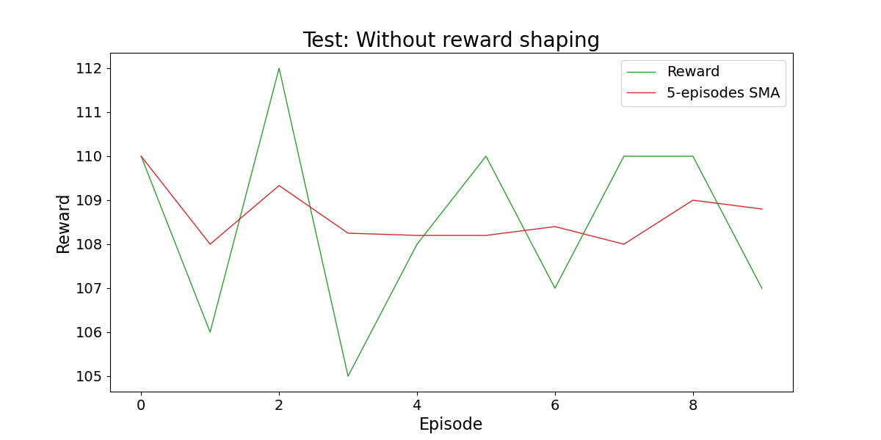
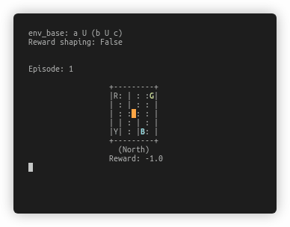
Results
Base environment goal
With Reward Shaping
Without Reward Shaping

Slide 26
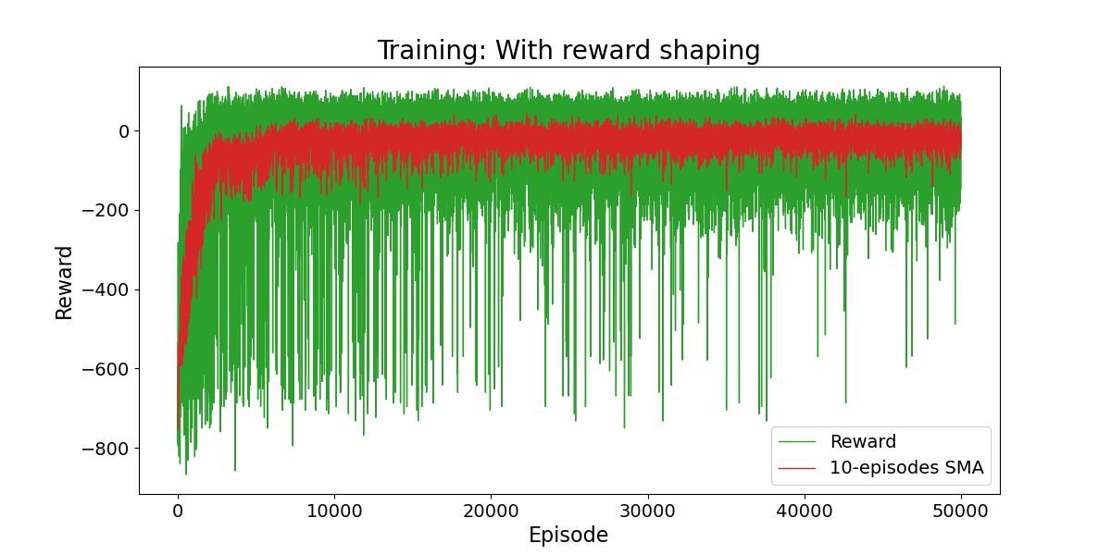
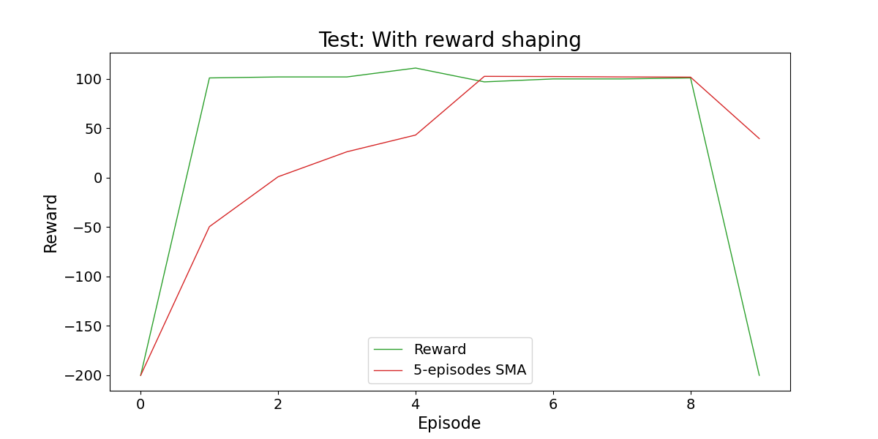
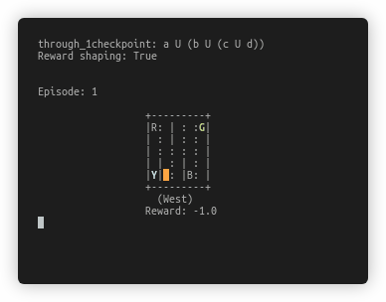
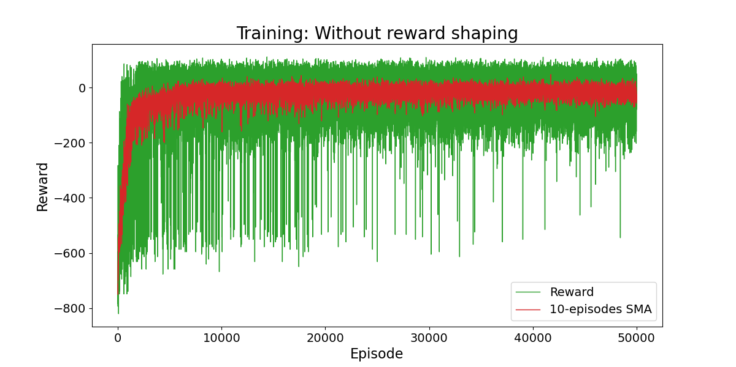
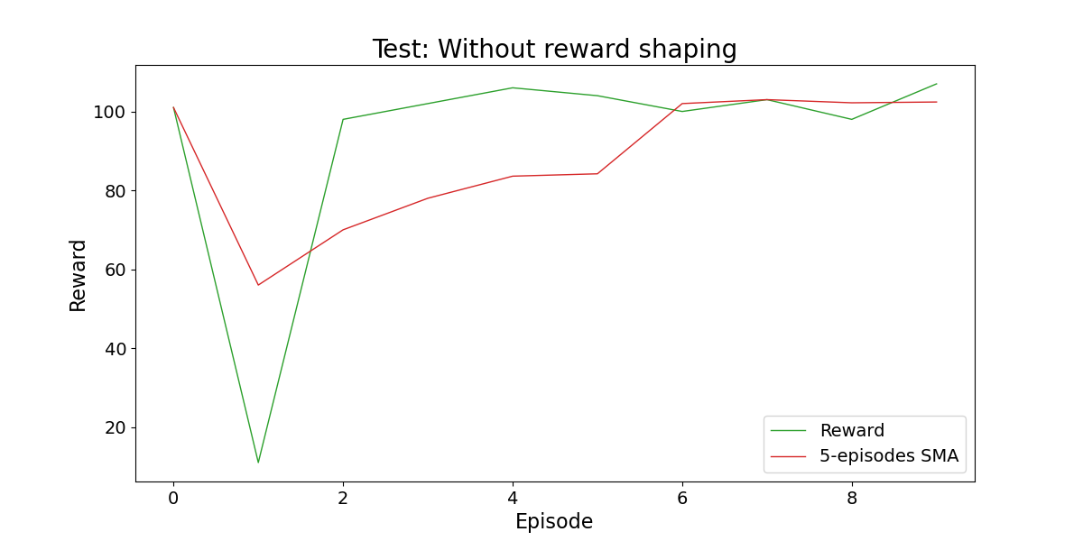
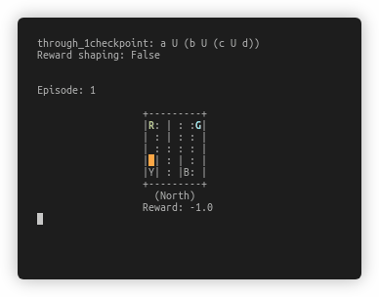
Results
Through 1 checkpoint
With Reward Shaping
Without Reward Shaping

Slide 27
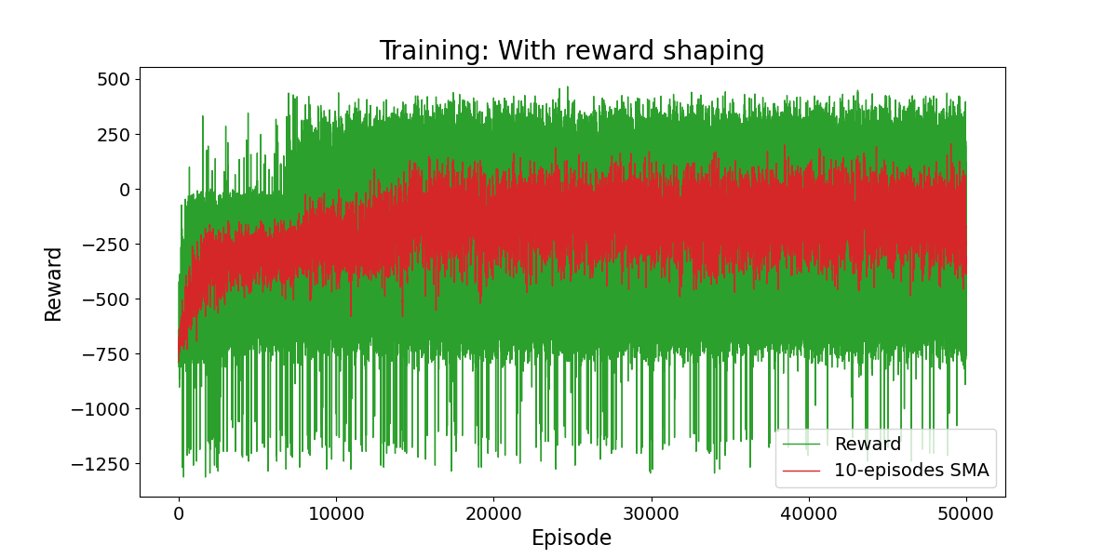
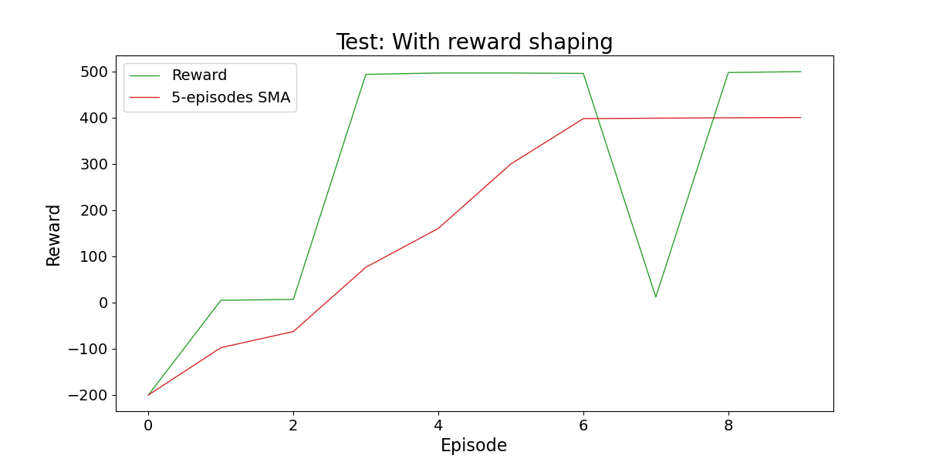
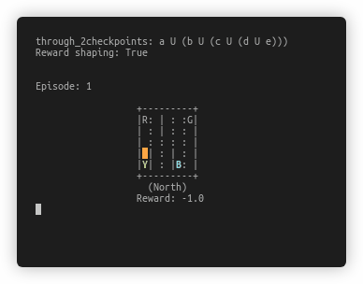
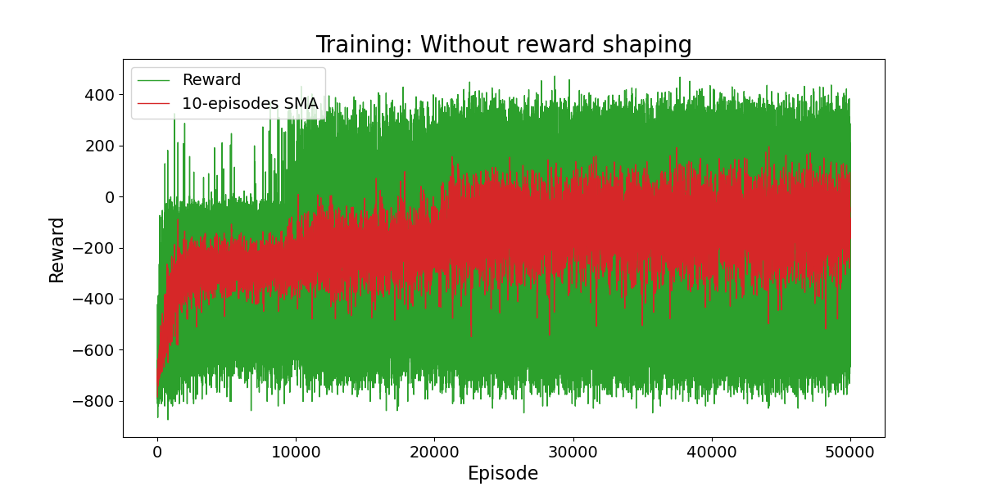
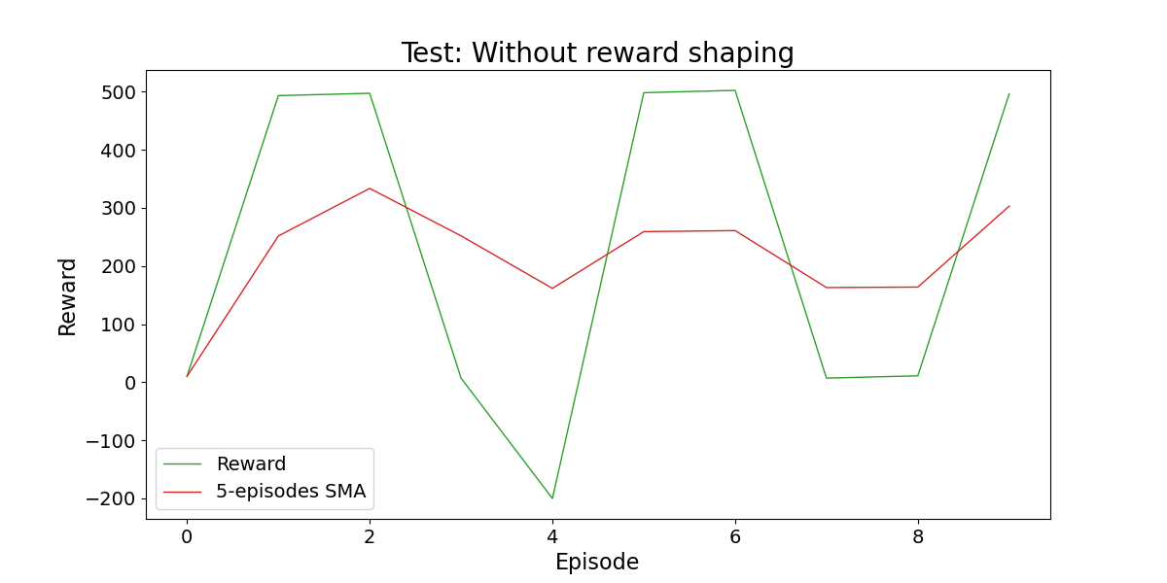
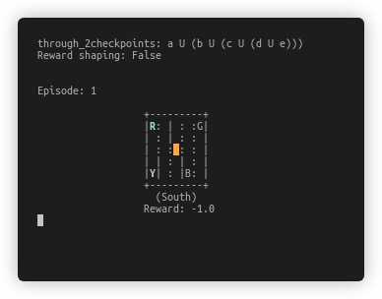
Results
Through 2 checkpoints
With Reward Shaping
Without Reward Shaping

Slide 28
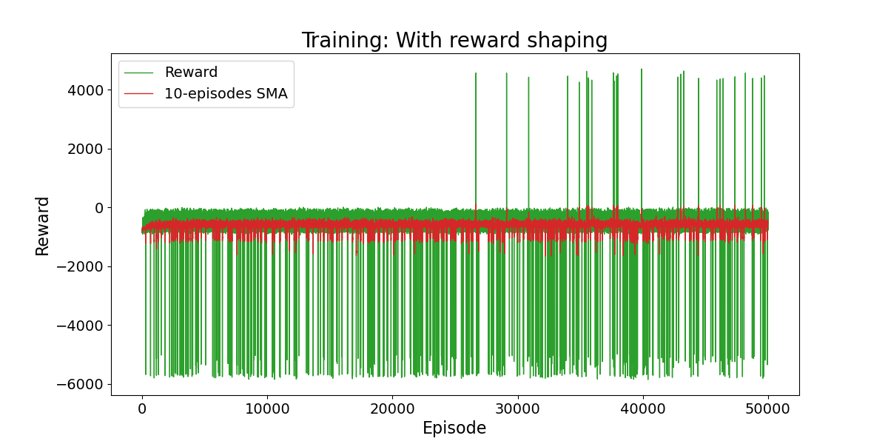
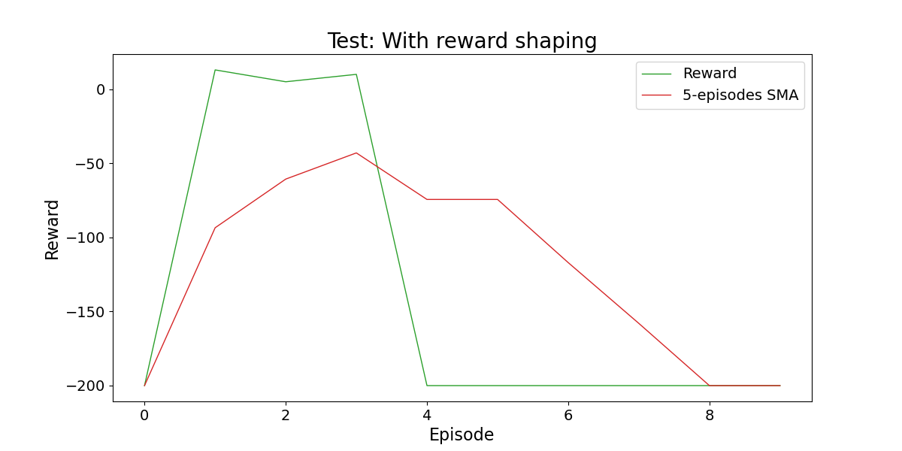
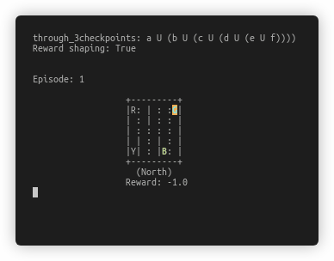
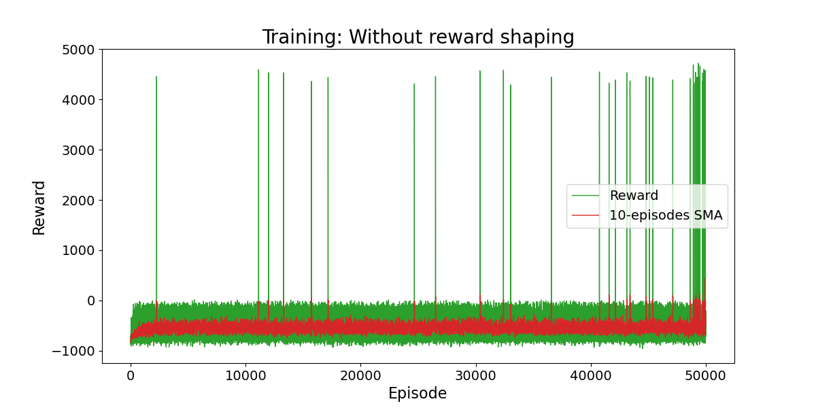
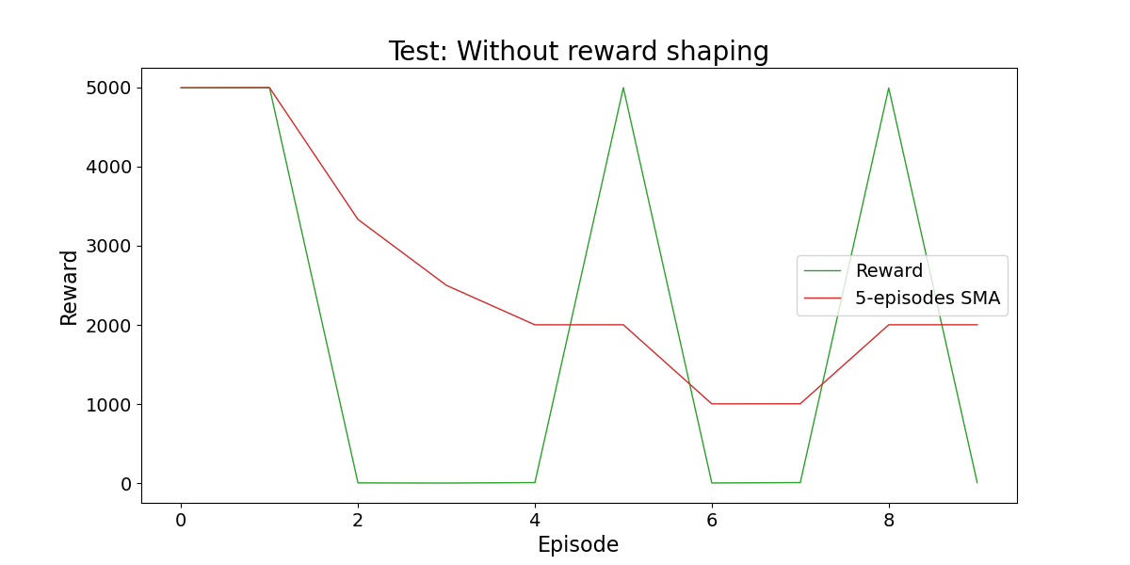
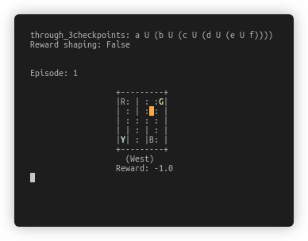
Results
Through 3 checkpoints
With Reward Shaping
Without Reward Shaping

Slide 29
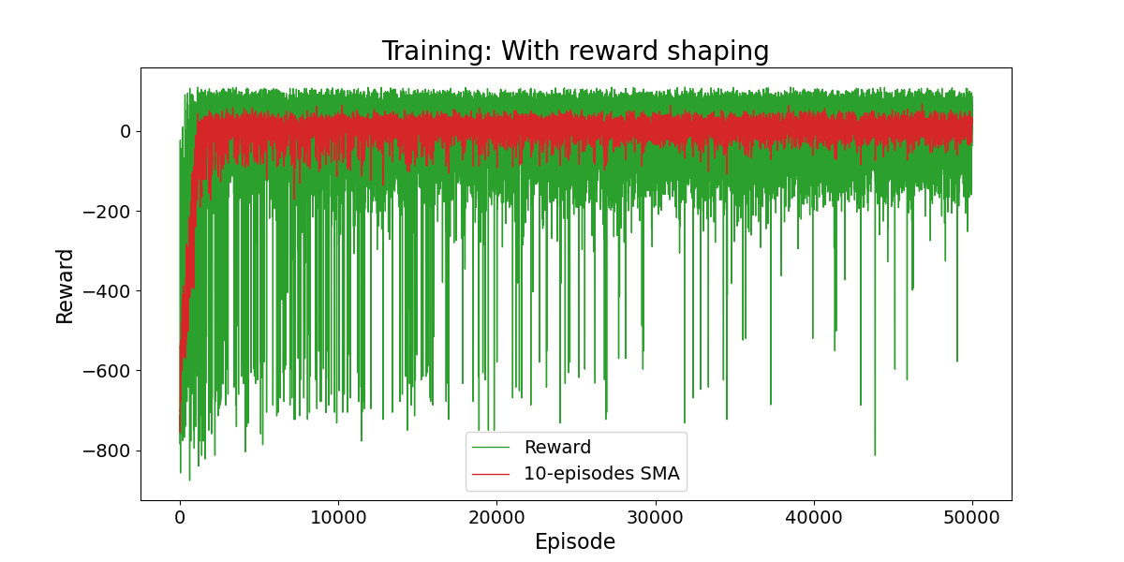
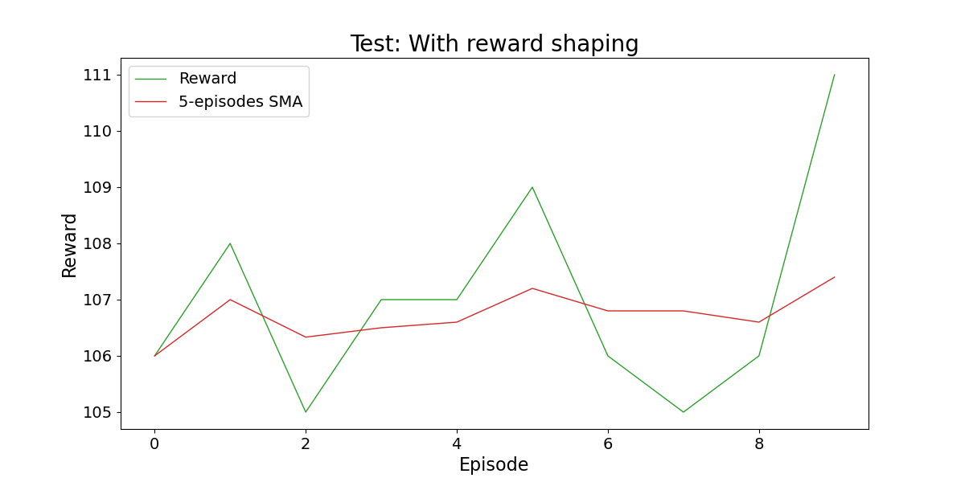
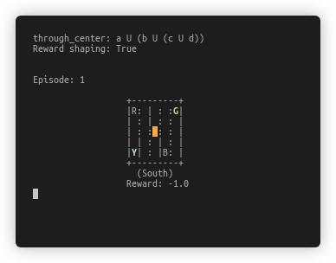
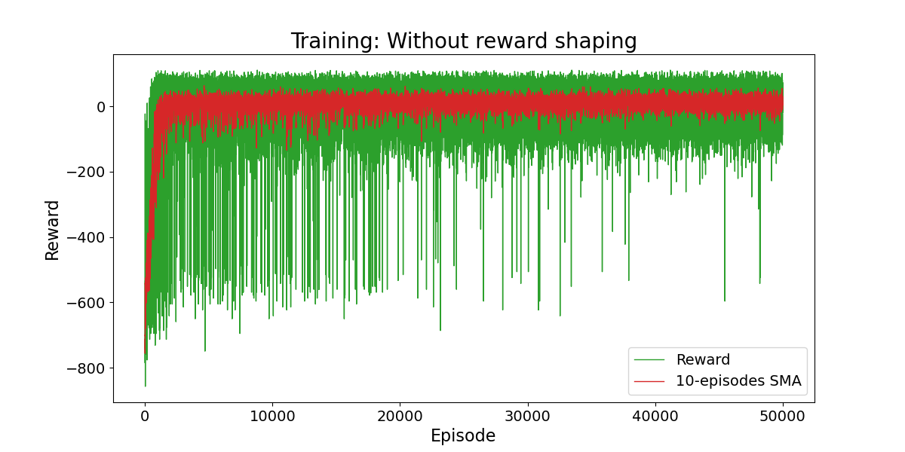
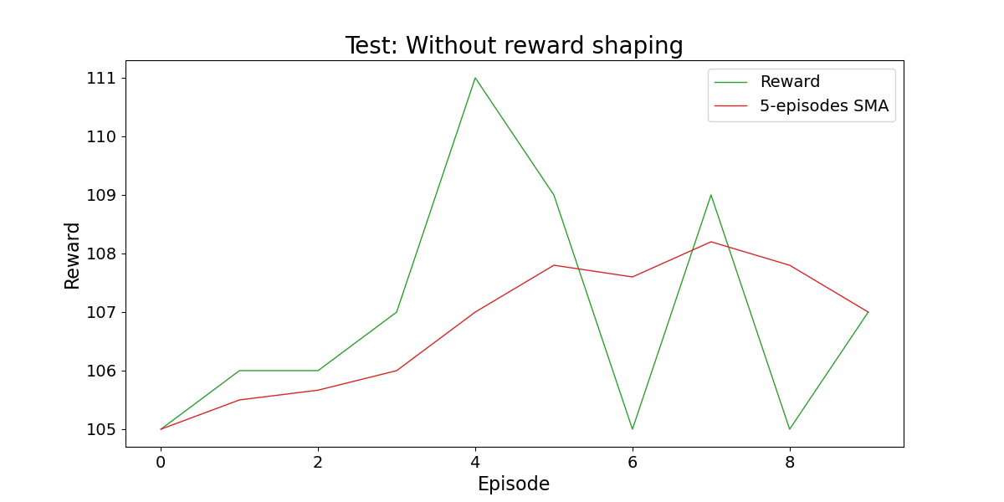
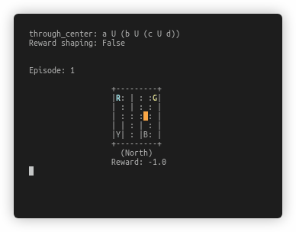
Results
Through center
With Reward Shaping
Without Reward Shaping

Slide 30



Results
STRIPS

Slide 31


Results
Overhead with STRIPS?
STRIPS
No Temporal Goal

